Slide 1
Foreign Policy and Diplomacy
(as a part of
International Security ,Diplomacy and Conflict Resolution)
Dr. H.Vageeshan,
Assistant Professor in Political Science
NALSAR University of Law
vagpolitics@gmail.com , vagpolitcs@nalsar.ac.in
Mobi:+919440253089

Slide 2
What will be discussed ?
National Interest and the context of it.
The concept of National Power in an interdependent world
What is Foreign Policy and its determinants .
Diplomacy and various kinds and possibilities
Basics of International Security

Slide 3
The Context in which the Nation States Operate .
Security
Economy
Identity
Are deemed as three prime movers of any nation state.
States , International Organizations, Transnational Orgnisations.
Do operate in the Arena of International Politics.
Ina situation where there is Crisis of Authority and Globalization and Inter Dependence Operate.

Slide 4
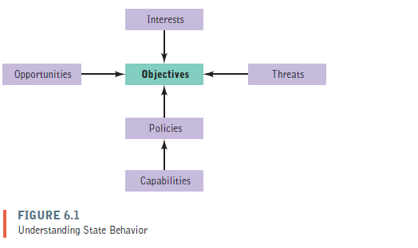
Basics of National Interest
Survival ,Economic Vitality, Core Values
Are the key components of national Interest
Notes:
International Relations and world Politics Viotti and Kuppi ( 2013)

Slide 5
Resources of National Power
Economic Resources
Human Capital.
Natural Resources.
Capital Resources.
Knowledge and Technology Resources.
Government Resources
Military Resources.
International Resources
Notes:
Bajwa ( 2008) Defining Elements of Comprehensive National Power
https://www.claws.in/images/journals_doc/1302263399_JSBajwa.pdf

Slide 6
Instruments prompting national Interest
Diplomacy
Propaganda
Imperialism and colonialism.
Coercive means
Economic Instruments
Alliances and Treaties

Slide 7
Foreign Policy
Foreign policy is the system of activities evolved by communities for changing the behavior of other states ,either through change or status quo, in order to ensure the maximum service of its interest and for adjusting their own activities to the international environment.
- (Modelski’s definations Improved by Mahender Kumar)
Notes:
https://www.politicalscienceview.com/determinants-of-foreign-policy/

Slide 8
Components of foreign policy
Policy makers,
Interest and objectives
Principles of foreign policy, and
Means of foreign policy
Notes:
https://www.politicalscienceview.com/determinants-of-foreign-policy/

Slide 9
Objectives of Foreign Policy
Maintaining the integrity of the state,
Promoting economic interest,
Providing for national security,
Protecting national prestige and developing national power, and
Maintaining world order.
The above can be supplemented by specific objectives according to the peculiar problems and conditions of the particular country

Slide 10
Foreign Policy Choices
Neutrality.
Alliance Building
Non Alignment
Waging War.

Slide 11
Diplomacy
Diplomacy is the management of international relations by communications, including negotiations at times leading to a bargain, or agreement. Indeed, the emphasis on negotiation is viewed by most people as the essence of diplomacy—negotiating a treaty , reaching an executive agreement ,or bargaining with another state over the terms of a proposed agreement.
Notes:
Viotti and Kuppi

Slide 12
The beginning of modern European Diplomacy
Treaty of Westphalia 1648 ( Ending the Religious Wars) .
Treaty of Utrecht 1713-15 ( Spanish Succession)
The Congress of Vienna (1814–1815) is of greatest historical importance.
Hague Conventions of 1899 and 1907
Paris Peace Conference, 1919 ( Versailles Peace Conferences)

Slide 13
The Six Technics of Modern Diplomacy
(i)Persuasion: Through logical reasoning
(ii)Rewards:
(iii) Promise of Reward and Concessions:
(iv)Threat of Use of Force:
(v) Non-violent Punishment: (By depriving a promised reward or concession)
(vi)Use of Pressure: ( Use of Force)

Slide 14
Various Types of Diplomacy
Politics of pacification
Gunboat Diplomacy
Dollar Diplomacy
Public Diplomacy
Peoples Diplomacy
Intermediary Diplomacy
Economic Diplomacy ( Done in international economic Forums )
Digital Diplomacy ( Use of Electronic communication an New Media)
Notes:
https://www.legit.ng/1131145-types-diplomacy-international-relations.html

Slide 15
Diplomatic and Consular Relations
Vienna Convention on Diplomatic relations 1961.
This convention formalized the conventional practices related to diplomacy. Diplomatic Immunities that means the special provision to the ambassadors and the key staff of the embassy are spelled out in this. In general Embassy will be deemed as foreign territory in the host country.
Vienna Convention on Consular Relations 1963
Consulate is an office forgien country to take care of trade and cultural relations. This is not an Embassy, but staff in these offices also got certain limited immunités.

Slide 16
International Security
International security is more than a study of threats, but also a study of which threats that can be tolerated and which require immediate action. Concept of security as not either power or peace, but something in between-
- Barry Buzan
Global security has five dimensions that include human, environmental, national, transnational, and transcultural security.-
- Nayef Al-Rodhan. .
Notes:
Buzan, B. People, States & Fear. Colchester, ECPR.
1. Buzan, B. (2007). People, States & Fear. Colchester, ECPR.
2. Al-Rodhan, Nayef R.F. (2007). "The Five Dimensions of Global Security: Proposal for a Multi-sum Security Principle", Berlin: LIT Verlag. ISBN 978-3-8258-0478-7.

Slide 17
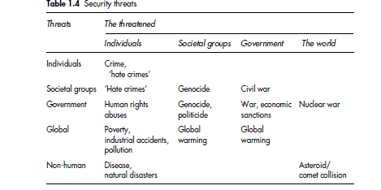
Types of security threats
Notes:
Hague Peter (2008) Understanding Global Security

Slide 18
Security Threats Create Conflicts
Resolution of conflict requires Diplomatic prowess and Hard and soft powers.
Diplomatic and Military means may be employed to resolve conflicts and deal with Security Threats.
In many cases Use of force may not work as an option to resolve conflicts .In such cases we have to use diplomatic and Intentional Law based means to resolve conflicts .

Slide 19
The points to Ponder.
How is the current globalization is providing opportunities and challenges to the Nation states?
What are the processes of Making Nation Powerful or Influential in the international arena ?
What are the determinants of foreign policy ?
How does diplomacy work?
What is international Security?

Slide 20
Useful Links and Material
Viotti.Paul .R. and Kuppi. Mark .V. . (2013) International Relations :World Politics, Pearson. ( Chapters 6,7,9,10 For Power,Foreign Policy, Diplomacy, Conflict)
https://www.rand.org/topics/global-security.html ( Gives insights in to Global Security)
Hague Peter (2008) Understanding Global Security. Routlege, London.
https://www.youtube.com/watch?v=Ef6MCdtgqYE&list=PLloO_FPkrr1ttCchRtp-z0HPDQaJh1N-S ( A serious of 17 Lectures on IR Lecture 7 on Foreign Policy and Lecture 10 useful).

Slide 21

THANK YOU

